Slide 1
Composite products.
Rules for entry into the European Union.
DG SANTE-UNIT A5
Bilateral Relations Unit
Dr S.Coulon

Slide 2
Why New Rules?
Public and health risk
EFSA Opinion 2012
% of PPOAO irrelevant
Commission Delegated Regulation (EU) 2022/2292 of 6 September 2022 supplementing Regulation (EU) 2017/625 of the European Parliament and of the Council with regard to requirements for the entry into the Union of consignments of food-producing animals and certain goods intended for human consumption.
Commission Delegated Regulation (EU) 2019/625

Slide 3
Main points
1. Definition
3. Hygiene food rules. Ingredients of animal origin
5. Country of origin of the composite product
6. Residues control plan
7. Animal health aspects
8. Documentation
2. Category of composite product
4. Rules for establishments
9. Controls at the entry of the Union

Slide 4
1. What is a composite product?
Definition: food containing both products of plant origin and processed products of animal origin.
Unprocessed product of animal origin
Processed product of animal origin
Composite product
If the raw material is not a processed product of animal origin.
If there is not a plant product added.
If the plant product does not modify the main characteristics of the animal product.
Notes:
It is necessary to distinguish between composite products, processed products of animal origin (PPAO) and products, which could erroneously be considered as composite products. Though the decision should be made on the case by case basis, the following decision tree helps making a first assessment.
1. E.g. fresh salmon tartare, fresh chicken skewers with pepper, sushi.
2. smoked fish, yoghurt, grilled chicken breast / tuna steak in sunflower oil, yoghurt with fruit, canned minced beef with vegetables.
3. biscuits with eggs or butter, precooked hamburger in a bun, cream liqueurs, burrito, pizza with salami and cheese, chicken Caesar salad (with chicken, parmesan cheese).

Slide 5
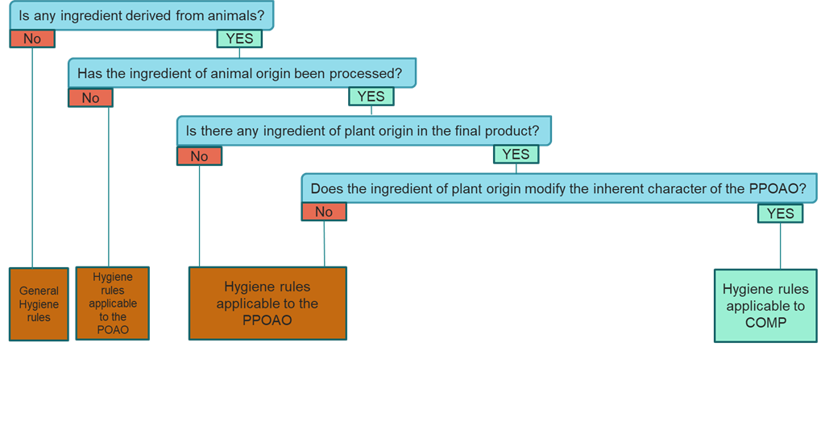
1. What is a composite product?

Slide 6
2. Categories
Non shelf-stable
Shelf-stable. Containing colostrum-based products or processed meat
Shelf-stable. Containing PPOAO (R (EC) 853/2004). Not containing colostrum-based products or
processed meat
COMMISSION DELEGATED REGULATION (EU) 2022/2292

Slide 7
3. Ingredients of animal origin. Food Hygiene.
All processed products of animal origin contained in the composite products must come from EU approved establishments located in countries authorised to export such processed products of animal origin to the EU.
Regulation (EC) No 853/2004 of the European Parliament and of the Council of 29 April 2004 laying down specific hygiene rules for food of animal origin

Slide 8
4.Establishments producing COMP. Food Hygiene.
As a general rule R(EC) 852/2004
ComP produced |  | ComP-producing establishment
From PPOAO previously processed in an EU approved establishment | Without further processing | Registered
 | With a further processing of the PPOAO as part of the processing of the final ComP such as cooking biscuits using an egg product | Registered
 | With a further processing of the PPOAO, independently from the processing of the final ComP such as processing a dairy product into milk powder to make ice-cream. | EU-approved
From unprocessed products of animal origin that will be processed in the establishment manufacturing the ComP |  | EU-approved
Notes:
Regulation (EC) No 853/2004 does not apply to the production of COMP. The risk posed by the ingredient of animal origin can be controlled by implementing the rules of Regulation (EC) No 852/2004 without there being a need to apply more detailed specific requirements.
Therefore, establishments producing COMP where all animal origin ingredients are already processed, are only to be registered by the CA, do not need to be approved.

Slide 9
5. Country of origin of the COMP
Listed in Commission Implementing Regulation (EU) 2021/404 or Commission Implementing Regulation (EU) 2021/405 as relevant.
Non shelf-stable
Processed product of animal
Shelf-stable. Containing colostrum-based products or processed meat.
Colostrum-based products.
Meat products.
Shelf-stable. Containing PPOAO (R (EC) 853/2004). Not containing colostrum-based products or processed meat.
Meat products, fishery products, dairy products, or egg products.
Notes:
1. For each processed product of animal origin contained in the composite product.
2. For the meat product contained in the composite product.

Slide 10
6. Residues Monitoring Plan
The country of origin of the composite product must be listed in Annex –I to COMMISSION IMPLEMENTING REGULATION (EU) 2021/405 (for the species/commodities from which the processed products of animal origin contained in the COMP are derived)
For each processed product of animal origin contained in the composite product exported to EU.
Exception of collagen, gelatine and the highly refined products listed in Section XVI, point 1, of Annex III to Regulation (EC) No 853/2004.

Slide 11
6. Residues Monitoring Plan
Symbol | Meaning
X | The country of origin of the COMP has an approved residue control plan (RCP) as regards pharmacologically active substances and residues thereof, contaminants and pesticide residues.
Δ | The country of origin of the COMP only uses raw material either from Member States or from other third countries approved for entry into the Union of such raw material (and listed with an “X” for the commodities included in the COMP).
O | The country of origin of the COMP has an “X” in Annex -I for certain categories. Then the country of origin of the COMP can request to be additionally marked with an “O”, in the table of Annex -I, for the remaining of these categories not marked with an “X”.
P | The country of origin of the COMP has an “X” in certain categories. Then the country of origin of the COMP containing processed products derived from bivalve molluscs originating either in Member States or in third countries or regions thereof authorised for the entry into the Union of consignments of live, chilled, frozen or processed bivalve molluscs, echinoderms, tunicates and marine gastropods (listed in Annex VIII to Regulation (EU) 2021/405), could request to be additionally marked with a “P” for aquaculture in the table of Annex -I

Slide 12
7. Animal health aspects
As general rule:
(Listed on R (EU) 2021/404 as follows)
Origin of the COMP:
Country listed for the PPOAO contained in the COMP for the entry into the Union.
Obtention of the PPOAO:
- In the same listed country of the origin of the COMP.
-In the EU.
- Other country listed for the PPOAO contained in the COMP (withouth risk-mitigating treatment):
. Annex XVII
. Annex XV
. Annex XIX
Dairy products
Meat products
Egg products

Slide 13
7. Animal health aspects
By way of derogation:
(Listed on R (EU) 2021/404 as follows)
Origin of the COMP:
- No risk-mitigating treat, from country listed Annex XVII.
-Treated, country listed Annex XVII or XVIII.
-Treated at least equivalent, country listed for meat, dairy or eggs or fishery products.
Shalf-stable COMP containing DAIRY PRODUCTS
Obtention of the PPOAO:
- No risk-mitigating treat, from country listed Annex XVII.
-Treated, in EU or country listed Annex XVII or Annex XVIII.
- Treated at least equivalent, in EU or country listed Annex XV or XIX.

Slide 14
7. Animal health aspects
By way of derogation:
(Listed on R (EU) 2021/404 as follows)
Origin of the COMP:
- Treated at least equivalent, country listed for meat, dairy, eggs or fishery products.
Shalf-stable COMP containing EGG PRODUCTS
Obtention of the PPOAO:
-EU or country listed Annex XIX.

Slide 15
8. Documents
Non shelf-stable
Official Certificate.
(Chapter 50 of Annex III of Commission Implementing Regulation (EU) No 2020/2235)
Shelf-stable. Containing colostrum-based products or processed meat other than gelatine, collagen or HRP.
Official Certificate.
(Chapter 50 of Annex III of Commission Implementing Regulation (EU) No 2020/2235)
Shelf-stable. Containing PPOA (R (EC)853/2004) Not containing colostrum-based products or processed meat other than gelatine, collagen or HRP.
Private attestation
(Annex V of Commission Implementing Regulation (EU) No 2020/2235)

Slide 16
8. Documents: Other documents
The GEL certificate established in Chapter 41 or the COL certificate set in Chapter 42 of Annex III to Implementing Regulation (EU) 2020/2235
For shelf-stable COMP contains gelatine or collagen derived from ruminant bones.
Appropriate documentation to support that (i.e: trade documents, commercial documents, invoices, etc.)
For shelf-stable COMP containing PPOAO for which no requirements are laid down in Annex III of Regulation (EC) 853/2004,

Slide 17
9. Controls at the entry: Border Control Post
In general: Composite products are subject to BCP controls. Listed in Regulation (EU) 2021/632
Exception. Composite products not subject to BCP controls:
Shelf-stable. Not containing colostrum-based products or processed meat.
Listed in the Annex of Commission Delegated Regulation (EU) 2021/630

Slide 18
Derogations
Article 20.4 of Commission Delegated Regulation (EU) 2022/2292:
Requirements for third countries elaborating CP
Requirements on RMP
Requirements on documentation
Shall not apply to shelf-stable composite product where all the animal products present in the final composite product fall within the scop of:
- Regulation (EC) No 1332/2008 of the European Parliament and of the Council.
- Regu­lation (EC) No 1333/2008 of the European Parliament and of the Coun­cil.
- Regulation (EC) No 1334/2008 of the European Parliament and of the Council.
Or that animal part is vitamin D3 only.

Slide 19
Annex III R (EC) 853/2004
Article 20.3 of Commission Delegated Regulation (EU) 2022/2292:
If the PPOAO contained in the shelf-stable COMP does not have specific requirements laid down in Annex III to Regulation (EC) No 853/2004, then the rules of Article 20.2 (c) on third countries of origin of the COMP do not apply.

Slide 20
Supporting material
EU entry conditions for composite products
Q&A document on Composite Products

Slide 21
Thank you
© European Union 2023
Unless otherwise noted the reuse of this presentation is authorised under the CC BY 4.0 license. For any use or reproduction of elements that are not owned by the EU, permission may need to be sought directly from the respective right holders.
Slide xx: element concerned, source: e.g. Fotolia.com; Slide xx: element concerned, source: e.g. iStock.com

