Slide 1
Official controls on products of non-animal origin introduced into the Union
EU imports conditions – Vietnam
Dr S.Coulon – DG Santé A5
Bilateral International relations unit

Slide 2
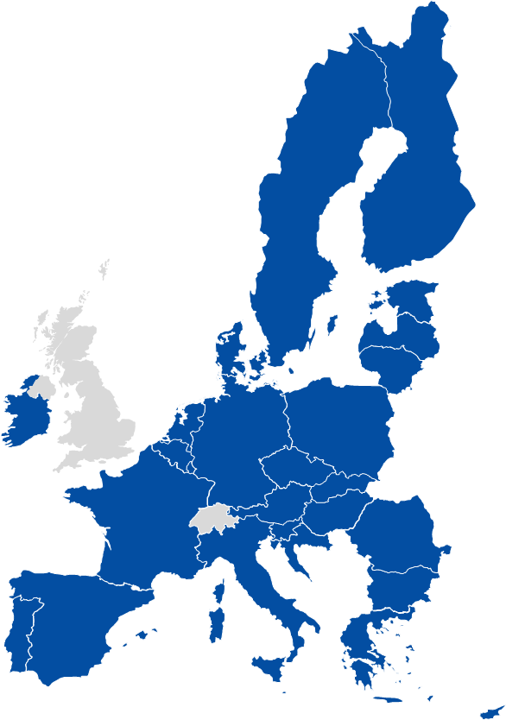
EU single market
free circulation of goods, people and services
harmonized rules for agri-food trade
harmonized rules for official controls
businesses and products on the market
products entering the Union

Slide 3
EU legal framework
Main regulation: General Food Law (GLF Reg 178/2002)
Main regulation : Official Controls Regulation (Reg 2017/625)
LEGISLATION ON FOOD HYGIENE
for Food Business Operators
LEGISLATION ON OFFICIAL CONTROLS

Slide 4
Official controls regulation
a harmonised framework for the organisation of official controls and official activities along the entire agri-food chain
since 12/2019
Official Controls Regulation (OCR)
2017/625
Extended scope
OCR Art 2(1)
NEW
NEW
NEW
NEW
NEW
NEW
Food and food safety
Feed and feed safety
animal health
animal welfare
GMOs
animal by-products
plant protection products
plant health
organics
PDO, PGI, TSG

Slide 5
The risk based approach
Controls to be performed "regularly, on a risk basis and with appropriate frequency"
Risks associated with animals and goods, activities, location…and the likelihood that consumers might be misled
Own controls, including private quality schemes
Operator's past record

Slide 6
Operators are responsible
"Union agri-food chain legislation is based on the principle that operators at all the stages of production, processing and distribution which are under their control are responsible for ensuring compliance"

Slide 7
Structure of Regulation 2017/625 (OCR)
General Principles Articles 1 – 15
Subject matter, scope & definitions, Competent Authorities general requirements
Sector Specific Requirements Articles 16 – 27
e.g. Products of animal origin, residues, animal welfare, plant health, GMOs, plant protection products, organic production, new risks
Art. 28–33
Delegation of tasks
Art. 34–42
Sampling, analyses, tests + Diagnoses
Art. 43– 76 CONTROLS
Entry into the Union
Art. 77-91 Financing OC + official certification
Art. 92-101
EURLs
EURCs
Art. 102–108
Administrative Assistance
+ Cooperation
Art. 109-115
Planning + Reporting
Art. 116–124
Commission Controls
Art. 125–129
Conditions for entry into the EU
Art. 130
Training (BTSF)
Art. 131–136
IMSOC
Art. 137– 141
Enforcement
Common Provisions - Articles 142 – 167

Slide 8
OCR 2017/625 Title II Chapter V:
Official controls on animals and goods entering the Union
I section Articles 44-46
II section Articles 47-64
OC shall be organized on a risk basis and with appropriate frequency
OC shall be performed on each consignment
at the border control post of first arrival into the Union
Animals and goods, excluding those subject to official controls at BCP
in accordance with Section II
• animals
• products of animal origin, germinal products, animal by-products, hay and straw, composite products
• plants, plant products, and other objects (listed in the Regulation (EU) 2016/2031)
• goods from certain third countries with temporary increase controls due to a known or emerging risk
• animals and goods which are subject to an emergency measure in accordance with Article 53 of Regulation (EC) No 178/2002
If there is a suspicion that there is a risk OCs may include: • transport, including where empty
• packaging, including pallets
At BCP;
At points of entry into the EU;
At the points of release for free circulation;
At the holding of the operator (warehouses and the premises);
At the places of destination.
Operators must ensure that animals and goods are submitted to official controls at BCP
Notes:
VM: slide is adapted.

Slide 9
Entry into the Union – Main rules
“Low risk" “High risk"
Animals and goods whose inherent risks do not require systematic border controls =
An appropriate place within the customs territory of the Union
Animals, products of animal origin, germinal products, animal by-products, plant, plant products and certain feed and food of non-animal origin* =
Designated BCP of first arrival
Regular, risk based controls with appropriate frequency (established by MS)
Always documentary checks; risk based identity and physical checks
Same set of measures in cases of non-compliance, including enforcement measures
* A list with CN codes to be established
Notes:
A common, risk based framework for border controls on all animals and goods entering the EU.
Border Control Posts (BCPs) will replace the different Border Inspection Posts (BIPs) and Designated Points of Entry (DPEs). Minimum requirements for facilities, equipment and staff qualifications will apply throughout all BCPs.
A single standard document (CHED) will be used by operators for the prior notification of consignments.
Transmitted to the BCP through IMSOC which will allow for the integration of existing computerised systems (including Europhyt).

Slide 10
Official controls on ‘Low risk’ goods
Based on Chapter V, Section I, Articles 44 to 46 of Regulation (EU) 2017/625 (OCR)
Risk based
Appropriate frequency
History of compliance with the requirements (Third country, exporter, operator)
Official controls performed within the Union

Slide 11
Official controls on ‘High risk’ goods
Based on Chapter V, Section II, Articles 47 to 72 of Regulation (EU) 2017/625 (OCR)
List of goods subject to official controls at the Border control posts are established based on empowerment of Article 47 of OCR

Slide 12
Common framework for border controls
A common, risk based framework for border controls on all animals and goods entering the EU
Border Control Posts (BCPs) replace
Border Inspection Posts (BIPs)
Designated Points of Entry (DPEs)
Common Health Entry Document
(CHED) single standard document for the prior notification of consignments and recording results of official controls
Minimum requirements for
facilities - equipment - staff
Data transmitted through IMSOC = integration of existing computerised systems (including TRACES, RASFF, Europhyt)
Notes:
In the area of border controls, the Regulation of 2017 introduces a holistic approach: official controls on animals, plants, food and feed are to be performed according to harmonised principles, in unified „border control posts“ and increasingly with digital tools.
In around 30 delegated and implementing acts, the Commission has specified further details regarding the performance of border checks:
Common requirements for the infrastructure and qualifications of staff performing border checks
Requirements for border checks and their frequency, using information from IMSOC
Phytosanitary checks on wood packaging material entering the EU with any commodity, with the aim of getting a better overview on possible risks to plant health
Simplified rules on transit

Slide 13
Import control, OCR 2017/625 Chapter V
II section Articles 47-64
Official controls at Border Control Posts on animals and goods (BCP)
Border Control Posts (BCP) and designated control points
Operators must ensure that consignments are delivered
Minimum requirements for infrastructure, equipment and staff
OCR Art. 64;
Regulation (EU) 2019/1014;
Regulation (EU) 2019/1012 - derogations from BCP requirements
Prior notification of shipments shall be a single standard document - CHED part I (Traces NT)
Regulation (EU) 2019/1715 (IMSOC Regulation)
Documentary, identity and physical checks.
Physical checks and decisions on the consignment are carried out by the
official veterinarian* or official plant health officer.
The findings / decisions of the official controls carried out shall be recorded - CHED part II. The original official certificates or electronic equivalents are kept by the CA of BCP.
The customs shall allow the consignment to be released for free circulation only on presentation of a completed CHED certifying that the consignment is in conformity
Notes:
VM: slide is adapted.
The list of CN-Codes for controled commodities is provided to customs and so uploaded to their system, so when commodity is declarated for transit or import procedures, customs see the need for CHED.

Slide 14
Border control process
Prior notification and exchange of information
Presentation and controls at the BCP
Decision and follow-up on the consignment
CHED, TRACES
Mandatory control but risk based identity and physical checks
CHED, TRACES, customs' single window

Slide 15
Checks on BCPs
Hygiene package
OCR & related rules
Fundamental import principles
Authorised country/region
Approved monitoring plan if required
Approved establishment
Valid health certificate or document
e.g. Regulation (EU) 2019/2130, establishing detailed rules on documentary checks, identity checks and physical checks at border control posts

Slide 16
IMSOC
Information Management System for Official Controls
= integration of existing IT systems
TRACES
IMSOC
iRASFF
Imports / exports / certification
Rapid Alert System for Food and Feed (RASFF)
Administrative Assistance and Cooperation (AAC)
Food Fraud Network (FFN)
EUROPHYT
ADIS
Plant Health (outbreaks)
Animal Health (outbreaks)

Slide 17
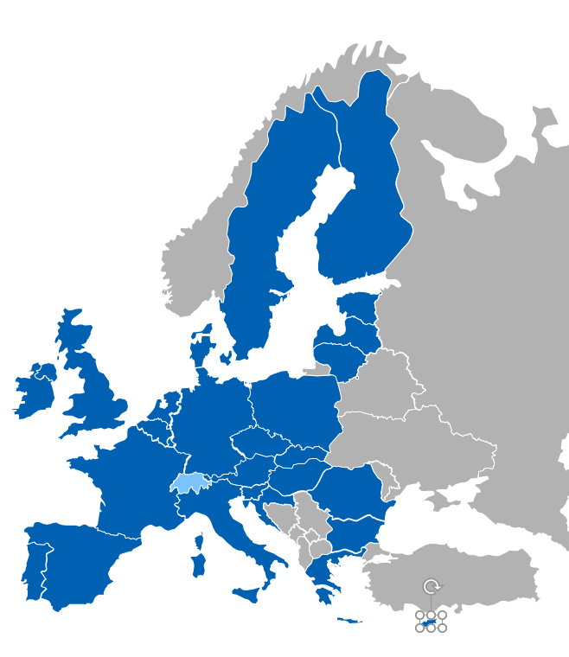
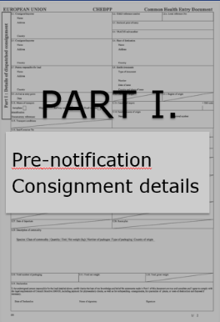
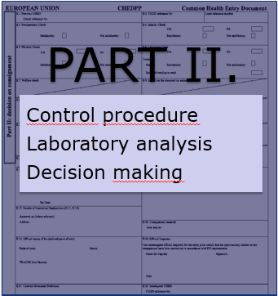
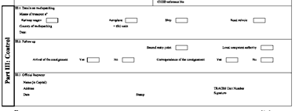
Use of Common Health Entry Document (CHED)
(OCR Article 56;57)
Issued for or each consignment under the OCs;
Operator shall complete the part I of the CHED - prior notification to CA (Art. 56 (3)(a));
CA records of the outcome of the performed OCs in the part II of the CHED;
The Customs authorities shall allow the release of the consignment for free circulation only if the CHED has been completed and the CA confirms that the consignment complies with the rules.
EO
CA EU borders
BCPs of arrival
PART III
Follow up control

Slide 18
Use of Common Health Entry Document (CHED) (OCR Article 58)
Commission shall lay down rules on the format of the CHED and the instructions for its presentation and use;
Communication through the IMSOC (OCR Art. 131-136) – Information management system for official controls :
Implementing Regulation (EU) 2019/1715 (IMSOC - Regulation)
CHED-A … Common Health Entry Document for Animals
CHED-P … Common Health Entry Document for Products
CHED-D … for Feed and food of non-animal origin
CHED-PP… for plants and plant products
Notes:
VM: Commission shall, in collaboration with the Member States, set up and manage a computerised information management system for official controls (IMSOC), through which data, information and documents concerning official controls and other official activities are managed, handled, and automatically exchanged.

Slide 19
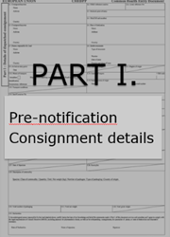
PRIOR NOTIFICATION - CIR (EU) 2019/1013 (OCR Article 58)
Prior notification must be:
done by the operator;
before consignments entering the Union;
one working day (24 h) before arrival of the consignments;
through the IMSOC.
Exemptions:
In cases due to transport-related logistical constraints, if it may not be possible – 4 h before arrival.
In order to give sufficient time for the CA to organize the controls at the BCP designated for imports of unprocessed logs and wood - up to five (5) working days.
Notes:
VM: 2. This may for example be the case when the consignment is transported from the place of dispatch to the border control post in less than 24 hours.
3. At the border control post designated for the aforementioned goods can be performed by a mobile official controls team.

Slide 20
Detailed rules of
DOCUMENTARY, IDENTITY and PHYSICAL checks at BCP (OCR Art. 52) - Regulation (EU) 2019/2130
Documentary checks:
all official certificates, official attestations and other documents or their electronic equivalents submitted in IMSOC;
(CHED) fully and correctly completed Part I by operator.
Identity checks (frequency based on a risk) - following elements of the consignments correspond to the information provided in documents:
content;
quantity;
appropriate stamps and identification marks or codes;
identification of the means of transport;
seals on containers or means of transport.

Slide 21
Detailed rules of
DOCUMENTARY, IDENTITY and PHYSICAL checks at BCP (OCR Art. 52) - Regulation (EU) 2019/2130
Physical checks:
Check on animals or goods, packaging, the means of transport, labelling and temperature, the sampling for analysis, testing or diagnosis and any other necessary check to verify compliance with the rules of Art. 1(2) of the OCR – refer to Union Agri food chain rules;
Physical checks (frequency based on a risk):
Physical checks on animals shall be carried in accordance with the detailed rules set out in Annex I;
Physical checks on products of animal origin, germinal products, animal by-products, derived products, hay and straw and composite products and on food and feed of non-animal origin subject to temporary increase of controls shall be carried out in accordance with the requirements set out in Annex II;
Physical checks on plants shall be carried in accordance with the detailed rules set out in Annex III.
Detection of hazards/ Laboratory tests:
Products of animal origin, germinal products, animal by-products, derived products, hay and straw and composite products;
Shall be carried out in accordance with the MONITORING PLAN
Notes:
Slide adopted for Physical checks.

Slide 22
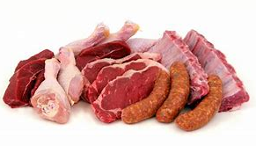
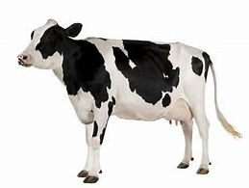
Official certification based on Art. 90(a) of the OCR and Art. 238(3) AHL
“IA FOOD”
“IA TERRE”
“IA AQUA”
Commission Implementing Regulation (EU) 2020/2235
standard model of certificates,
model certificates and private attestation for goods
Commission Implementing Regulation (EU) 2021/403
model certificates and declarations for terrestrial animals and germinal products thereof
Commission implementing Regulation (EU) 2020/2236
model certificates and declaration for aquatic animals and products thereof
INTRA-3
ENTRY-52
Declarations - 6
INTRA-65
ENTRY-68
Declarations - 2
INTRA-7
ENTRY-1
Declaration - 1
INTRA-65
ENTRY-68
Declarations - 2
From 169 current models under 30 acts to 162 revised models under 3 new acts
Corrections still to be made in the coming months, in particular to the references to legal acts establishing list of countries

Slide 23
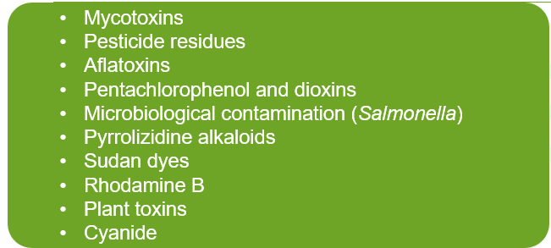
Implementing Regulation (EU) 2019/1793
Commission Implementation Regulation (EU) 2019/1793 lays down rules on the temporary increase of official controls and special conditions for food and feed of non-animal origin from certain third countries at the entry into the Union, due to the risk of contamination by different hazards.
At the moment, the Regulation includes products related to the following hazards:

Slide 24
Regulation (EU) 2019/1793 (1)
Regulation (EU) 2019/1793 lay down:
list of food and feed of non-animal origin subject to temporary increased of official controls in accordance with Article 47(2)(b) of OCR.
list of food and feed of non-animal origin subject to special conditions in accordance with Article 53(1)(b) of Regulation No 178/2002
frequency of identity and physical checks including laboratory sampling

Slide 25
Regulation (EU) 2019/1793 (2)
identification of packages of the consignment (Article 9)
sampling requirements (Article 10)
requirements for issuance of official certificate (Article 11)
model of official certificate (Annex IV)
requirements for performance of official controls at the border control posts products of non-animal origin listed in that Regulation

Slide 26
Lists of food and feed of non-animal origin subject to official controls upon entry into the Union Regulation (EU) 2019/1793
Annex II
Food and feed of non-animal of non-animal origin subject to special conditions (certificate + analysis results) and increase of official controls
Annex I
Food and feed of non-animal of non-animal origin subject to temporary increase of official controls
Annex IIa
Food and feed of non-animal of non-animal origin subject to suspension of entry into the Union

Slide 27
Annex I – increased official controls (Regulation (EU) 2019/1793)
Increased official controls at the border control posts of entry into the Union
Measures affecting operators and indirectly third country
Required prenotification with first part of CHED-D – Regulation (EU) 2019/1013
Documentary control and randomly selected consignments for identity and physical checks including sampling.
The frequency of identity and physical checks, including sampling and laboratory analyses, are laid down in Annex I to Regulation (EU) 2019/1793

Slide 28
Annex II - special conditions (Regulation (EU) 2019/1793)
Special import conditions – specific responsibility is placed on competent authorities of third countries.
Consignments should be accompanied by:
Results of sampling and test results;
Official certificate issued by the competent authority of third country
Required prenotification with first part of CHED-D – Regulation (EU) 2019/1013
Documentary control and randomly selected consignments for identity and physical checks including sampling
The frequency of identity and physical checks, including sampling and laboratory analyses, are laid down in Annex II to Regulation (EU) 2019/1793

Slide 29
Implementing Regulation (EU) 2019/1793 – Annexes I and Annex II
Commodities in Annexes are listed on the basis on combination of :
Origin
Description of commodity
CN code
Hazard
The same commodity may be listed for one or more hazards

Slide 30
Implementing Regulation (EU) 2019/1793 – Annexes I
⁽³⁾ Residues of at least those pesticides listed in the control programme adopted in accordance with Article 29(2) of Regulation (EC) No 396/2005 of the European Parliament and of the Council of 23 February 2005 on maximum residue levels of pesticides in or on food and feed of plant and animal origin and amending Council Directive 91/414/EEC (OJ L 70, 16.3.2005, p. 1, ELI: http://data.europa.eu/eli/reg/2005/396/oj) that can be analysed with multi-residue methods based on GC-MS and LC-MS (pesticides to be monitored in/on products of plant origin only).
⁽¹²⁾ Residues of Dithiocarbamates (dithiocarbamates expressed as CS2, including maneb, mancozeb, metiram, propineb, thiram and ziram), Phenthoate and Quinalphos.
⁽¹³⁾ Residues of Ethylene Oxide (sum of ethylene oxide and 2-chloro-ethanol, expressed as ethylene oxide). In case of food additives, the applicable MRL is 0.1 mg/kg (LOQ). Prohibition of use of Ethylene Oxide provided for in Commission Regulation (EU) No 231/2012 of 9 March 2012 laying down specifications for food additives listed in Annexes II and III to Regulation (EC) No 1333/2008 of the European Parliament and of the Council (OJ L 83, 22.3.2012, p. 1, ELI: http://data.europa.eu/eli/reg/2012/231/oj).

Slide 31
Implementing Regulation (EU) 2019/1793 –Annex II
⁽³⁾ Residues of at least those pesticides listed in the control programme adopted in accordance with Article 29(2) of Regulation (EC) No 396/2005 of the European Parliament and of the Council of 23 February 2005 on maximum residue levels of pesticides in or on food and feed of plant and animal origin and amending Council Directive 91/414/EEC (OJ L 70, 16.3.2005, p. 1, ELI: http://data.europa.eu/eli/reg/2005/396/oj) that can be analysed with multi-residue methods based on GC-MS and LC-MS (pesticides to be monitored in/on products of plant origin only).
⁽⁷⁾ Residues of Dithiocarbamates (dithiocarbamates expressed as CS2, including maneb, mancozeb, metiram, propineb, thiram and ziram), Phenthoate and Quinalphos.

Slide 32
Regular reviews of Regulation (EU) 2019/1793 (Art. 12)
The Commission reviews the lists of commodities set out in the Annexes
On a regular basis (not exceeding six months).
In light of new information related to risks and non-compliance.
In case of an emerging risk/ widespread serious non-compliance with the Union agri-food chain legislation, a safeguard measure may be imposed at any moment, independent of the regular reviews, in reaction to imminent problems.

Slide 33
Implementing Regulation (EU) 2019/1793 simplified overview of the 6 months review cycle
Listing of new commodities
(proposed by the MS)
Official controls carried out by the MS on consignments entering the Union
(CHED-D)
Data analysis + approval
Internal analysis (EC)
Member States (together with EC – WG meeting)
Inter Service Consolation with other Commission services/DGs
Voting through the Standing Committee on Plants, Animals, Food and Feed (PAFF Committee) (MS representatives) (approval)
Increase/decrease of
frequency of identity and physical checks
Movement of commodities between Annex I
and Annex II
Data collection by the Commission:
Qlik Sense
RASFF
ESTAT data (trade)
Other available information
Delisting of commodities
from (EU) Reg. 2019/1793
Suspension of entry into
the Union (Annex IIa)
Compliance / non-compliance + risks
Communication with third countries
Notes:
Common Health Entry Document (CHED) (OCR Article 58)
- Communication with third countries about any changes related to the Regulation (new commodities listed, delisted, move between the two Annexes, changes in the frequency of checks) for products coming from their country.

Slide 34
Sources of information
Information exchanged between Commission and member States – proposals from MS for new listing or amendments
Information received from third countries –e.g actions taken to ensure compliance with the Union requirements
Information on Commission controls carried out in third countries
Information from European Food Safety authority
Records of results of official controls in TRACES-NT system
EUROSTAT
Rapid Alert System for Food and Feed (RASFF)
Data and information concerning consignments

Slide 35
Information retrieved for each commodity
Outcome of official controls carried out by MSs
Total number of consignments imported into the Union
Total number of selected consignments for identity and physical checks
Total number of unfavourable control results
Percentage of unfavourable results
Notifications in Rapid System for Food and feed (RASFF)
Not all non-compliances resulted as RASFF messages
Exceedance of MRL might result in chronic exposure and thus in long-term risk – no RASFF
RASFF issued only when acute/short term intake as a risk for human health
Calculated with PRIMo (pesticide Residues Intake Model) developed by EFSA
Trade volumes for concerned commodity

Slide 36
Reference period and considerations
Reference period for information collected for each commodity corresponds to full semester before a new review process is started:
January to June (S1 of year x)
July to December (S2 of year x-1)
Information from several semesters may be taken into consideration to asses specific trends, in order to ensure a fully informed decision.
Several factors are taken in consideration during assessment
Case by case assessment is made: depending on the combination of origin/ commodity/ hazard/ level of non-compliances detected

Slide 37
Possible decisions
Inclusion of a commodity in Annex
Deletion of a commodity from Annex
Deletion of commodity from one Annex and moved to another Annex
Increase or decrease frequency of identity and physical checks – 5%, 10%, 20%, 30%, 50%
Suspension of entry into the Union

Slide 38
Procedure
Data collection
Data analyses
Discussion with member States during working group meeting
Submission of the proposal for opinion of the Standing Committee on Plants, Animals, Food and Feed (PAFF)
After favourable opinion in the vote of the PAFF adopted by Commission
Letters with envisaged changes send to the competent authorities of the concerned third countries
Published in official Journal of the European Union
Sanitary and Phytosanitary (SPS) notification submitted to the World Trade organisation (WTO)

Slide 39
Methodology
Commission Notice on information related to risks and non-compliance in the context of periodic reviews of Commission Implementing Regulation (EU) 2019/1793 (OJ C 265, 11.7.2022, p.1)
EUR-Lex - 52022XC0711(01) - EN - EUR-Lex (europa.eu)

Slide 40
Conclusions (1)
Article 11 of Regulation (EC) No 178/2002 requires that any food imported into the EU comply with the relevant food safety requirements.
Official controls on products of non-animal origin normally are performed by MS in market as ‘low risk products’.
Regulation (EU) 2019/1793 lists commodities based on non-compliances detected by MSs during their official controls in market (‘high risk products’).

Slide 41
Conclusions (2)
Regulation (EU) 2019/1793 has been regularly reviewed taking into account results of official controls and other information.
Not all exceedances of MRL resulted in RASFF, there are gap between the exceedance of MRL and the risk for human health.
Operators need to pay attention to the safety of imported products before commodity listed in Regulation (EU) 2019/1793.
The EU is very open and transparent

Slide 42
See SANTE website for more information:
imported products - European Commission (europa.eu)

Slide 43
Thank you for your attention
Any questions

